Slide 1
INTERNSHIP PROJECT
E-Commerce Sales
Performance Analysis
Revenue Trends · KPI Deep-Dive · Strategic Recommendations
I

Slide 2
THE BUSINESS PROBLEM
?
📅
📊
What drives revenue?
When does demand peak?
Are KPIs on track?
Management needs to understand whether growth comes from more customers placing orders or from customers spending more per order, or both.
Without knowing which months produce the highest and lowest revenue, the business cannot plan inventory, staffing, or marketing spend efficiently.
Total Revenue, Order Volume, and Average Order Value must be tracked together to get a complete picture of commercial health and identify where to act.

Slide 3
SALES KPI SNAPSHOT
Core performance indicators from the Sales Overview dashboard
TOTAL REVENUE
TOTAL ORDERS
AVG ORDER VALUE
13.18M
96K
137.12
Sum of all order revenue across the full dataset period
Count of distinct order IDs placed by customers
Total Revenue ÷ Total Orders (AOV measure)

Slide 4
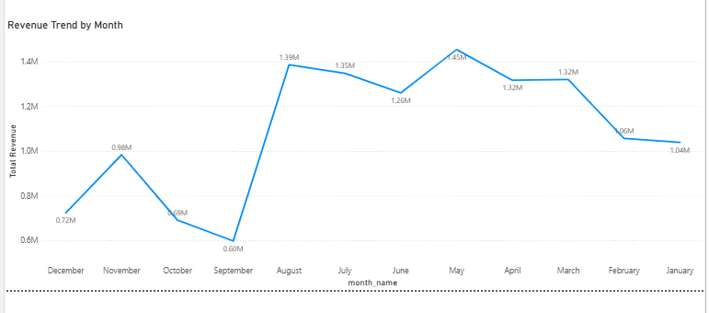
MONTHLY REVENUE TREND
Revenue Trend
📈 LINE CHART
Peak Month
Monthly Revenue by month_name (from dim_date)
× Total Revenue (from fact_orders)
May
Lowest Month
September
Jan Feb Mar Apr May Jun Jul Aug Sep Oct Nov Dec
Growth Shape
seasonal pattern with sharp rises and drops
Order vs Revenue
No clear alignment between order and revenue trends

Slide 5
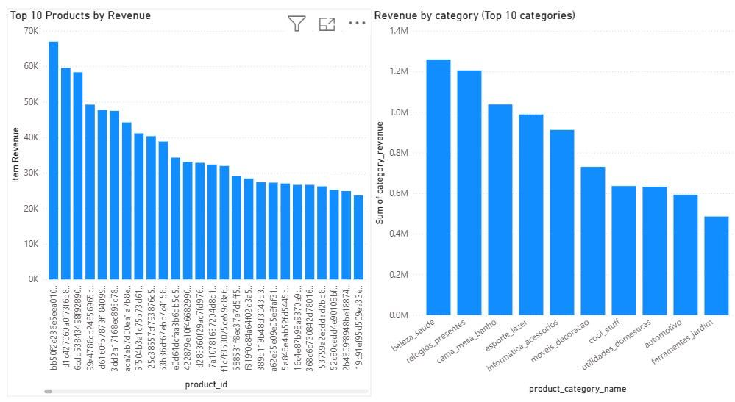
Product Performance Overview
Top category: Beauty and Health
Revenue concentrated in top categories
A small number of products generate a large share of revenue

Slide 6
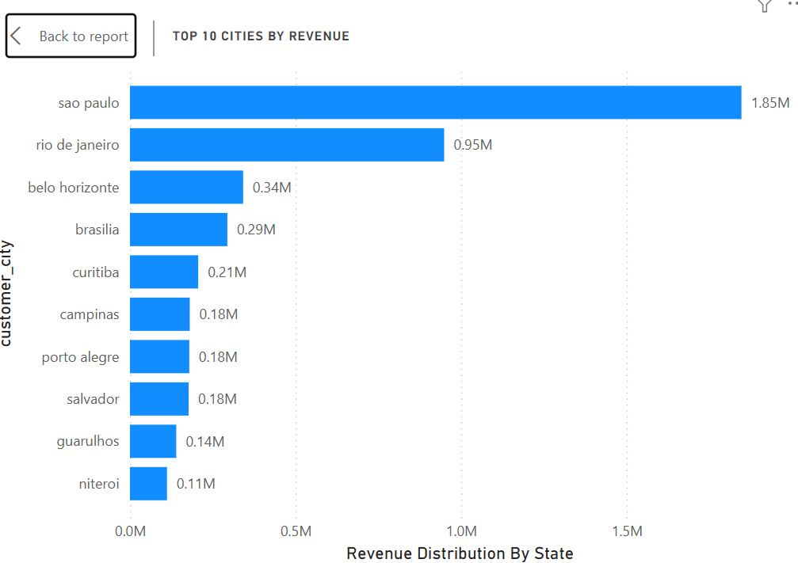
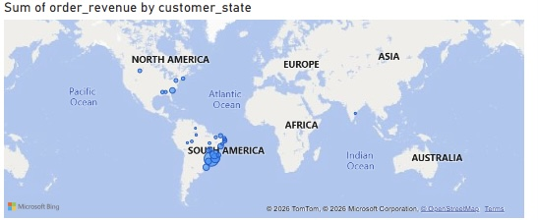
Regional Performance Overview
Sao Paulo is the top-performing city
Large gap between Sao Paulo and other cities
Revenue unevenly distributed across regions
Revenue is heavily concentrated in Sao Paulo (1.85M), nearly double Rio de Janeiro (0.95M)

Slide 7
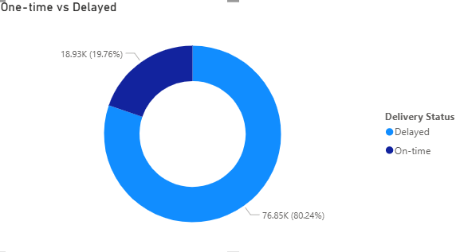
Delivery Performance Overview
Delayed orders negatively impact customer satisfaction and trust
Most orders are delivered on time (~80%), while around 20% are delayed
Delivery performance directly affects repeat purchases and customer retention
Improving logistics and reducing delays can significantly enhance overall performance
Filters help focus the analysis by selecting relevant data from the dataset

Slide 8
KEY TRENDS and INSIGHTS
01
Revenue is seasonal, not linear
02
Order volume is the primary growth lever
03
Low months represent the largest opportunity
Monthly revenue does not grow evenly. The line chart shows clear peaks and troughs likely tied to promotional events or consumer behaviour patterns indicating that demand is seasonal rather than driven by steady organic growth.
AOV tends to be relatively stable across months, which means revenue swings are driven predominantly by how many orders are placed not by customers spending more per visit. Increasing order frequency should be the main commercial focus.
The gap between peak and trough monthly revenue is significant. Targeted campaigns discount events, loyalty incentives, or bundled offers launched in low-performing months could materially improve annual revenue without increasing acquisition costs.
04
Category revenue is highly concentrated
05
Regional demand is uneven
The Product Performance page shows that a small number of categories generate a disproportionate share of revenue (visible in the clustered column chart). Protecting and growing these categories is critical to overall commercial health.
The Regional and Delivery Dashboard reveals that revenue is not distributed equally across states. High-revenue states represent a defensible base lower revenue states represent untapped expansion potential if delivery infrastructure and local marketing are invested in.

Slide 9
RECOMMENDATIONS
Practical actions derived from sales analysis
1
Double down on peak months
In May and August increase marketing investment ad spend, email campaigns, influencer activity in those periods by at least 20-30%. The demand already exists; the opportunity is to capture more of it.
2
Launch recovery campaigns in low months
For months with below-average revenue (September and October ), run targeted promotions: flash sales, loyalty bonuses, or bundle offers. Even a 10% lift in the weakest months can add meaningful annual revenue with minimal cost.
3
Pre build inventory ahead of demand peaks
Share the monthly trend data with the operations/logistics team. Begin stock planning 6-8 weeks before forecast peak periods to prevent stockouts and reduce last-minute procurement costs.

Slide 10
RECOMMENDATIONS
Practical actions derived from sales analysis
4
Invest in top-performing product categories
Concentrate supplier negotiations, product development, and merchandising budget on the categories that drive the highest share of revenue. Diversifying prematurely dilutes focus from proven winners
5
improve delivery operations
Invest in logistics infrastructure and optimize delivery processes to reduce delays and ensure faster order fulfillment, which enhances customer satisfaction and trust
6
Optimize delivery in weak regions
Identify underperforming regions and improve delivery efficiency by strengthening local logistics and distribution, leading to more reliable service and higher customer retention

Slide 11
Conclusion
• The analysis aimed to understand what drives revenue and how performance varies across time, products, regions, and delivery
• Results show that revenue follows a seasonal pattern, with clear peaks and low periods throughout the year
• Order volume is the main driver of revenue, while customer spending per order remains relatively stable
• Product categories and regions are unevenly distributed, with a strong concentration in top performers
• Delivery performance plays a critical role in customer satisfaction and overall business success
• By leveraging these insights and applying targeted strategies, the business can improve efficiency, increase revenue, and support long-term growth

Slide 12
Thank You
Business problem
Graphs
5 Key Insights
Recommendations
Conclusion
E-Commerce Sales Analysis | Internship Presentation

